Slide 1

LaTeX
System for Typesetting Documents
1. Introduction
Leszek J Chmielewski
Faculty of Applied Informatics and Mathematics – WZIM
Warsaw University of Life Sciences – SGGW

Slide 2
Concepts of document editing systems
What You See Is What You Get
What You See Is What You Mean
Separate contents from presentation

Slide 3
History
Donald Ervin Knuth & TeX + METAFONT
  1977 – 1978 – 2008
  1989, version 3, 256 characters
  2008, version 3.1415926
  only error corrections are planned,
  version numer tends to π
Plain TeX, LaTeX … BibTeX and others
Features:
  fonts of high quality
  good editorial pracitices, spaces, hyphenation
  perfectly typeset mathematical formulas
  …

Slide 4
Ten Reasons Why TeX is Better than Word
Output Quality – You write documents to be read
TeX has the best output.
TeX knows typesetting.
Superior Engineering
TeX is fast. It is easy on memory and disk space, too.
TeX is stable. It is in wide use, with a long history.
TeX is stable, but not rigid. A system locked into 1978's technology would today have gaps. That's why TeX is extendable, so that innovations can be added.
The input is plain text.
The output can be anything. As with inputting, TeX's outputting step is separate from its typesetting.
Freedom
TeX is free. Open source.
TeX runs anywhere. Whatever platform you use, you can get TeX.
Popularity
TeX is the standard.

Slide 5
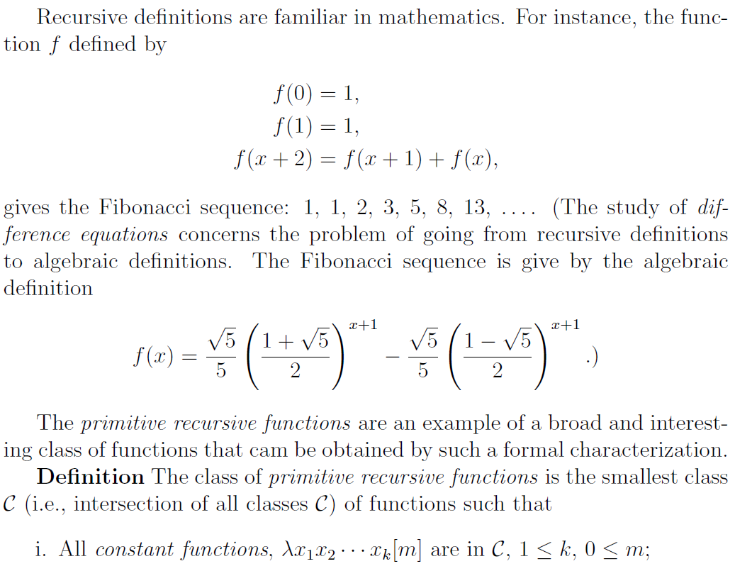
High quality attained easily

Slide 6
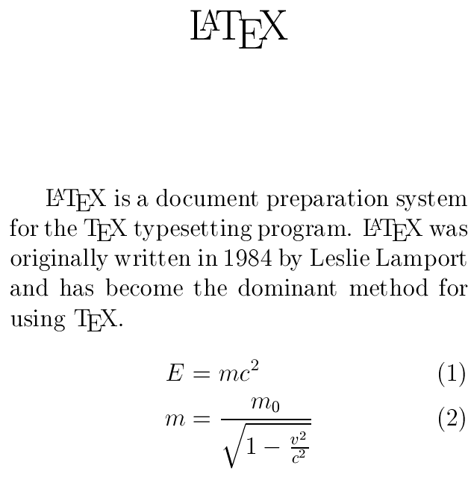
LaTeX – example
\documentclass[12pt]{article}
\usepackage{amsmath}
\title{\LaTeX} \date{}
\begin{document}
\maketitle
\LaTeX{} is a document
preparation system for the
\TeX{} typesetting program.
\LaTeX{} was originally written
in 1984 by Leslie Lamport and
has become the dominant
method for using \TeX{}.
% This is a comment
\begin{align}
E &= mc^2 \\
m &= \frac{m_0}
{\sqrt{1-\frac{v^2}{c^2}}}
\end{align}
\end{document}

Slide 7
Some exotic examples
The TeX showcase
http://www.tug.org/texshowcase/
  far beyond everyday use

Slide 8
Features and functionalities
Text is written with a plain text editor
Excellent font; publisher’s quality
Math formulas editing
Hyphentaion in any language
Environments (…items) & floats (…tables)
Including graphics in many formats
Labels and references to figures, tables, pages, items, literature; indexes, contents
Any page features, running head
Support for multilanguage documents
Literature bases formation
Uncountable packages for any purpose

Slide 9
Processing scheme
compilation
(TeX-ing)
>latex file.tex
Text source
file.tex
file.dvi
Viewing
>yap file.dvi
compilation
(PdfTeX-ing)
>pdflatex file.tex
file.log
>dvips file.dvi
>dvipdfm file.dvi
file.pdf
PostScript
file.ps
… .lof .lot .aux
.toc .ilg .idx…

Slide 10
Basics
White characters → 1 space
Empty line = new paragraph
Special characters
$ & % # ^ _ { } ~ \
\$ \& … \~{} $\backslash$
Commands and ignoring a space:
\command , \command{}, {\command}
space: {\ }
Commands with arguments:
\framebox{tekst in the frame box}
\framebox[120mm][r]{to the right}
Text …

Slide 11
Structure of a source file
%Class of the document (% is a comment sign)
\documentclass[12pt,a4paper]{article}
%Packages
\usepackage{polski}
\usepackage{graphicx}
%Packages with parameters
\usepackage[utf8]{inputenc}
\usepackage[english,polish]{babel}
%Global commands
\selecthyphenation{polish}
\textwidth{25cm}
\title{Title of the Paper} \author{FirtstName FamilyName}
%Text
\begin{document}
\maketitle
Contents contents…
\tableofcontents %Or other lists
\end{document}

Slide 12
Classes of documents
\documentclass[options]{class}
Classes: article, report, book, letter, …
Options: 10pt, 11pt, 12pt
a4paper, letterpaper,
fleqn, leqno,
titlepage, notitlepage,
onecolumn, twocolumn,
oneside, twoside,
openright, openany

Slide 13
Packages
\usepackage[options]{packagename}
inputenc, graphicx,
babel, polski,
amsmath, amssymb,
color, xy, fancyhdr, makeidx, …
Catalogue of LaTeX packages, searchable:
https://www.ctan.org/pkg

Slide 14
Page styles
\pagestyle{<style>}
<style>: plain, headings, empty
\thispagestyle{<style>}
More can be done with
\usepackage{fancyhdr}
You can always find a package with which more can be done

Slide 15
Document structure commands
\section{Title}
\subsection{Title}
\subsubsection{Title}
\paragraph{Title}
Empty line = new paragraph
New line (rarely used!)
\\ , \newline, \linebreak[n], \nolinebreak[n],
\newpage, \pagebreak[n] (n=1, 2, 3 is the measure of
how much we insist on making it)
\tableofcontents
\listoffigures
\listoftables

Slide 16
Hyphenation
If needed
In the preamble:
\selecthyphenation{english}
\hyphenation{dif-fi-cult-word other-dif-ficult-word hy-phe-na-te}
\hyphenation{fur-ther-word}
For a single instance of a word:
ve\-ry\-un\-known\-word
If line breaks are unwanted:
\mbox{+48 22 333 44 55}
J.~R.~R.~Tolkien Charles de~Foucault

Slide 17
Fonts and diacritic signs
Select the language:
  \usepackage[arabic]{babel}
  \selecthyphenation{english}
  \usepackage{polski} …
  \’{c} means: command ’ with parameter c
  \’{n}, \.{z}, \`{e}, \o{u}, \v{c}, but also
  \k{a}, \L etc. – see the Not so short…
It can be necessary to select the font set – let us postpone it for now

Slide 18
Fonts and tails – convenient way
Input encoding:
  \usepackage[utf8]{inputenc}
  \usepackage[cp1250]{inputenc}
Choose the language:
  \usepackage{polski}
  \selecthyphenation{polish}
Write in your Windows ąęłóćśźżń ĄĘŁÓĆŚŹŻŃ
In Win 7 it was crispy, in 10, 11 it is OK
UTF8 usually always works
There are few problems between systems
Here I shall use English as default

Slide 19
Installation and we start!
LaTeX 2. Introduction 19/20
The Comprehensive TeX Archive Network:
http://www.ctan.org
MiKTeX Project page:
http://miktex.org/
→ Download → Other Downlowads →
use (32- or rather) 64-bit version,
full (very large) or network (packages will be downloaded and installed on the fly)
We use TeXworks editor, standard …etc.
Have the basic manual always at hand
– The Not So Short Introduction…
http://www.ctan.org/tex-archive/info/lshort/

Slide 20
Open a new <name>.tex and write…
\documentclass{article}
\usepackage[utf8]{inputenc}
\title{Title}
\author{GivenName FamilyName}
\begin{document}
\maketitle
\section{Introduction}
Something…
\subsection{Subtitle}
Text…
\section{Conclusion}
Something else…
\tableofcontents
\end{document}
…and then press the green button. If errors then correct, press red, press green.

